Slide 1
The Presidency

Slide 2
44th President of the USA

Slide 3
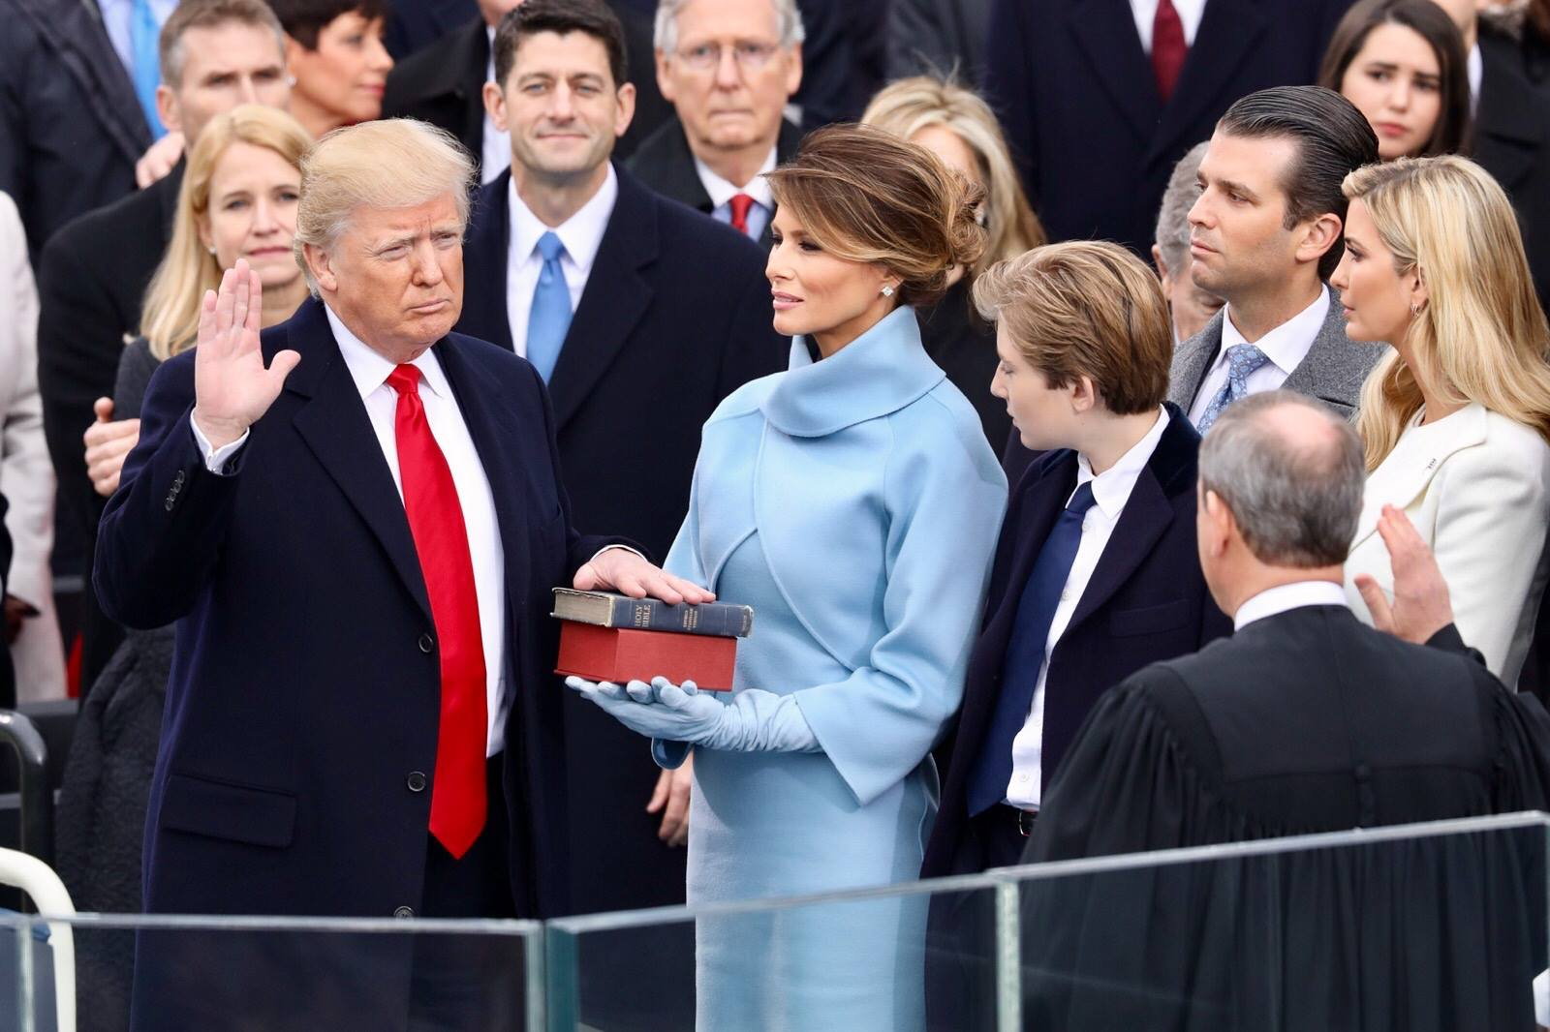
45th President of the USA

Slide 4
46th President of the USA ?
or

Slide 5
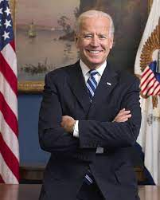
46th President of the USA

Slide 6
Qualifications
natural born citizen
at least 35 years old
lived in U.S. 14 yrs.

Slide 7
Pay & benefits
orig $25,000
now $400,000 plus a $50,000 expense acct.
White House etc.
Pension

Slide 8
Presidential roles
Chief Administrator
Chief of State
Chief Executive
Chief Diplomat
Commander in Chief

Slide 9
Presidential roles
Chief Legislator
Party Chief
Chief Citizen

Slide 10
Length of Term
not forever
22nd Amendment

Slide 11
Presidential Succession
9 Vice Presidents by succession
15 total

Slide 12
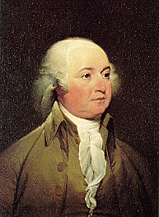
John Adams
“I am vice-president.
In this I am nothing,
but I may be everything.”

Slide 13
Succession ?
Presidential Succession Act of 1947
V.P. >Speaker > Pres. pro tem> et. al.
( list on page 371 )

Slide 14
Succession ?
25th Amendment
1. Provides for method of deciding disability of the president

Slide 15
Succession ?
2. Provides means to fill vacant vice presidency
ex. Ford, Rockefeller

Slide 16
Alben Barkley
story of woman w/ 2 sons.
“1 went away to sea & the other became Vice Pres. Neither of them were ever heard from again.”

Slide 17
However
the Vice President
is

Slide 18
Just a Heart Beat away

